Slide 1
The Adult Learner
Active Learning in Professional Education

Slide 2
Goals for this Hour
Identify characteristics of the adult learner.
Demonstrate importance of positive role modeling of desired behavior.
Evaluate the richness and availability of resources in the clinical site.
Share experiences and expectations about needs for further assistance in teaching others

Slide 3
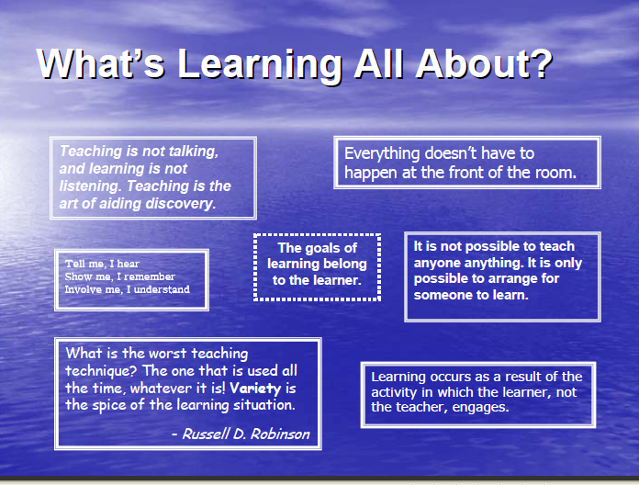

Slide 4
Recall your first day of clinicals….
What was a positive learning experience?
What was a negative learning experience?

Slide 5
Recall another memory of a recent conference or ACLS recertification or new product in-service….
What was a positive learning experience?
What was a negative learning experience?

Slide 6
Characteristics of the Adult Learner
1. Self-concept: As a person matures his self concept moves from one of being a dependent personality toward one of being a self-directed human being
2. Experience: As a person matures he accumulates a growing reservoir of experience that becomes an increasing resource for learning.
3. Readiness to learn. As a person matures his readiness to learn becomes oriented increasingly to the developmental tasks of his social roles.
4. Orientation to learning. As a person matures his time perspective changes from one of postponed application of knowledge to immediacy of application, and accordingly his orientation toward learning shifts from one of subject-centeredness to one of problem centredness.
5. Motivation to learn: As a person matures the motivation to learn is internal

Slide 7
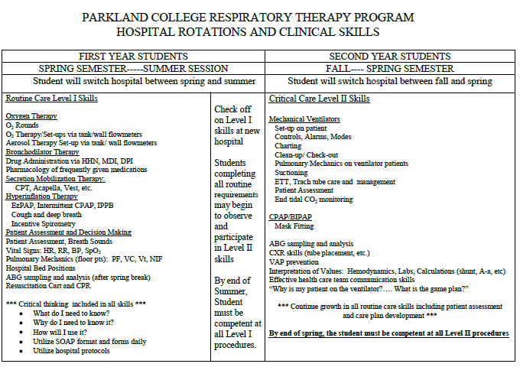
Choose Concepts to be Learned
Do they need the basics or technical information?
What is the current level of knowledge?
Begin where the learner is...

Slide 8
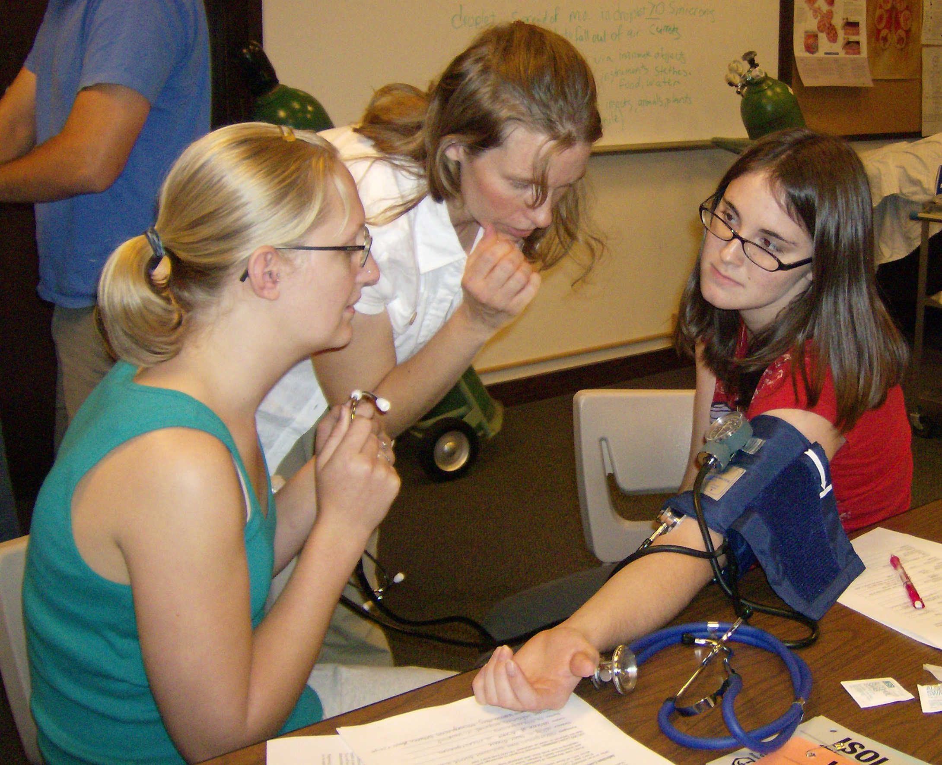
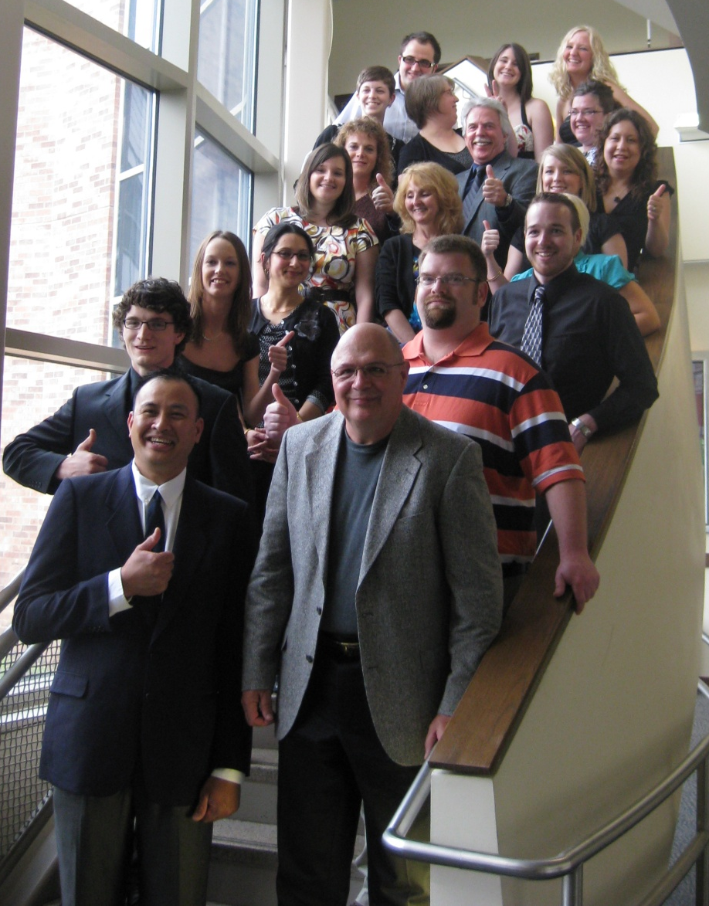
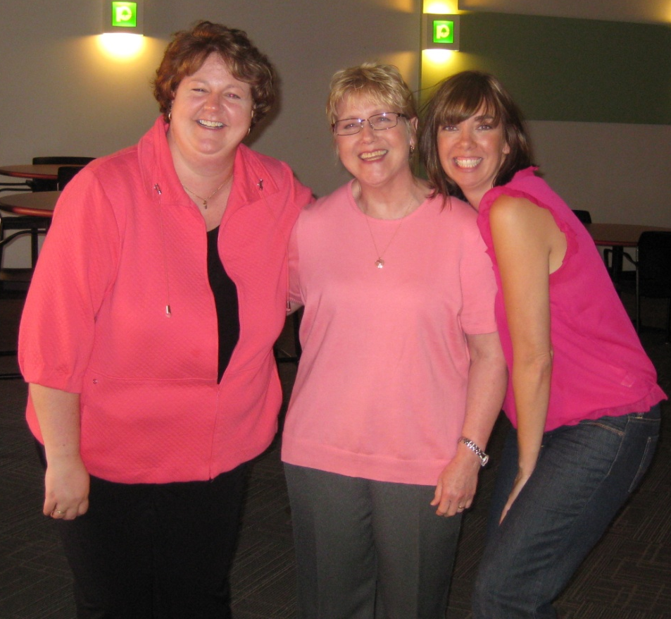
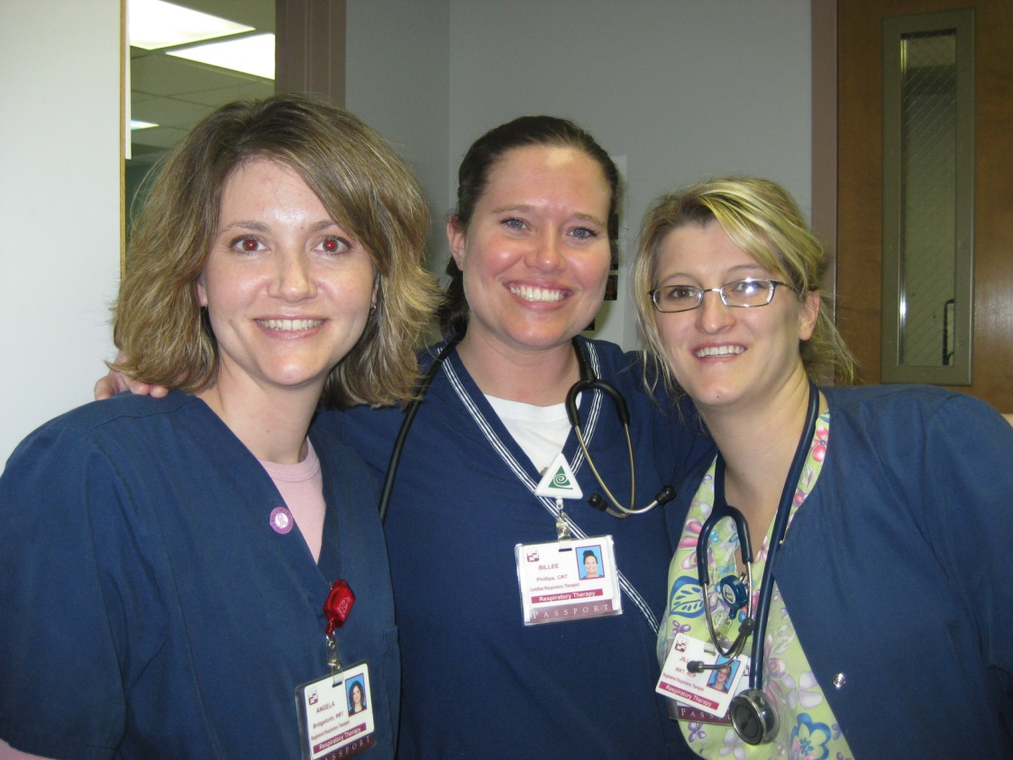
Self-Concept

Slide 9
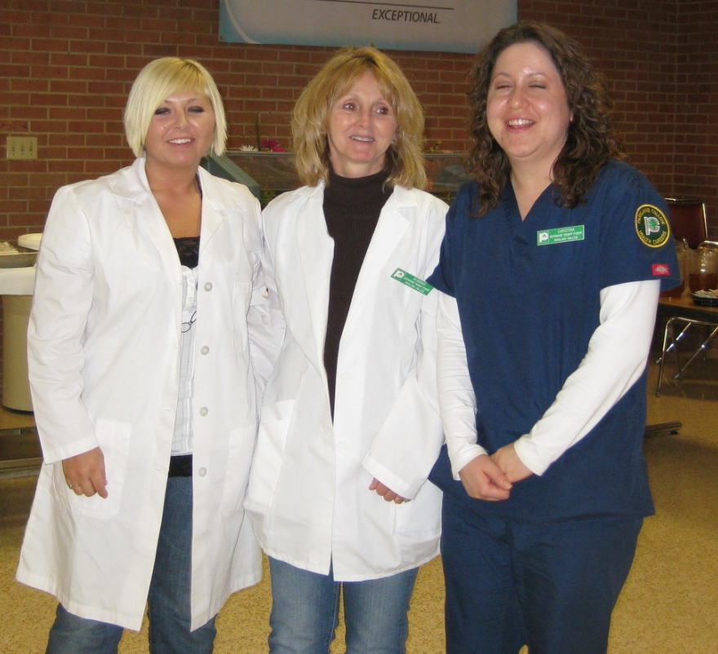
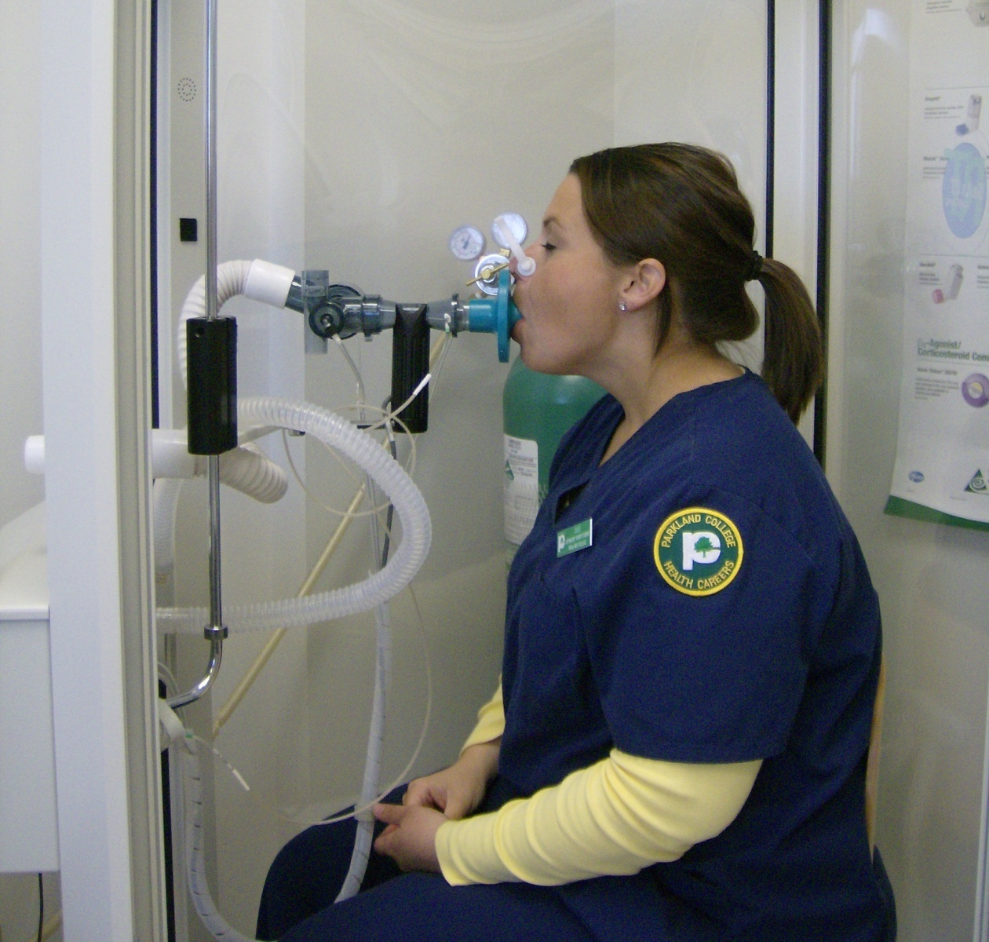
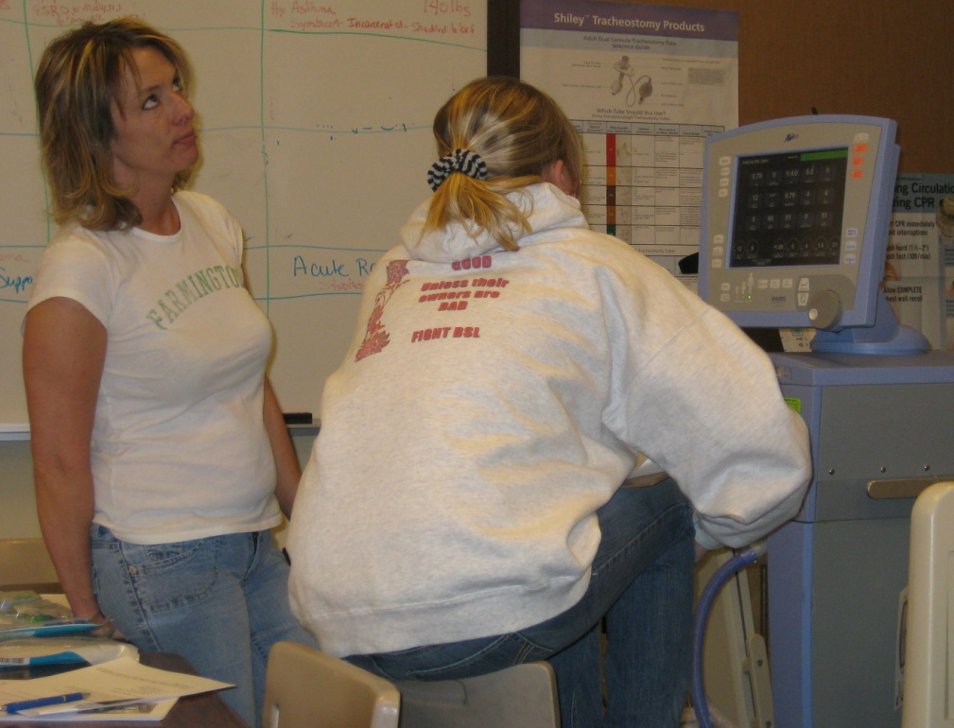
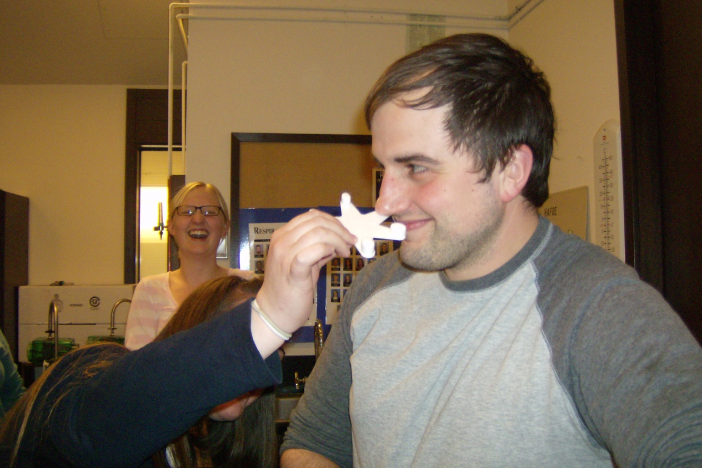
Motivation to Learn
Notes:
Extrinsic motivator
Intrisnsic motivator
Just because you have to
Just because it’s fun

Slide 10
Think back to a treasured mentor.
How did they utilize adult learning principles to enhance your learning experience.
Need to Know
Foundation
Self Concept
Readiness
Orientation
Motivation

Slide 11
Role Modeling
From Wikipedia, the free encyclopedia
The term role model first appeared in Robert K. Merton's socialization research of medical students.^{[1]} Merton hypothesized that individuals compare themselves with reference groups of people who occupy the social role to which the individual aspires.^{[1]} The term has passed into general use to mean any "person who serves as an example, whose behaviour is emulated by others".^{[2]}

Slide 12
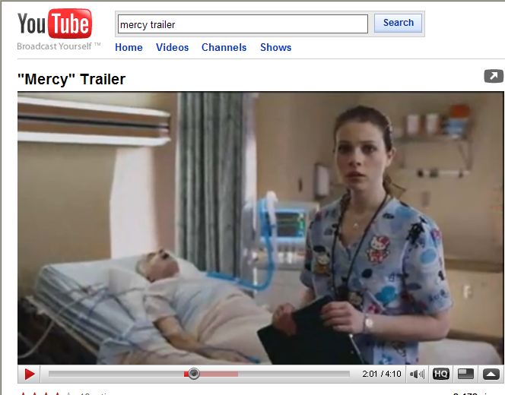

Slide 13
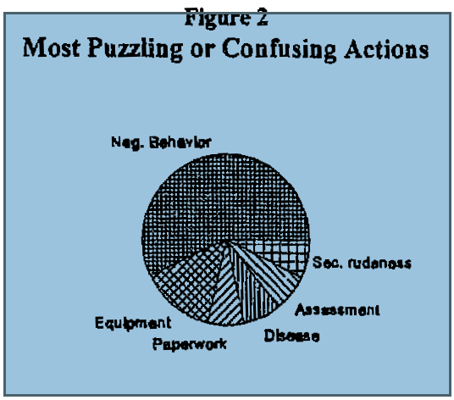
Sherise Valentine. Student Nurses’ Perceptions of Hospial Staff Modeling Behavior. ERIC 1997
Notes:
Students have difficulty processing visually confusing messages such as forgetting to use gloves, not following hospital policy and procedure, socially judgmental remarks that conflict with their view of the professional role.

Slide 14
Role Model Behaviors in the Clinical Setting
"
Demonstrates use of equipment unique to the setting.
Demonstrates nursing care procedures.
Asks questions regarding the patient's condition.
Reports clinical data to staff personnel in a timely fashion.
Uses therapeutic communication skills with each patient.
Interacts with physicians in a confident manner.
Identifies self to patients when first meeting them.
Demonstrates up-to-date nursing practices.
Is neat and clean in professional appearance.
Displays sense of humor in appropriate context.
Demonstrates ability to care for patient's needs.
Pitches in" when necessary to assist students.
Demonstrates a caring attitude toward patients.
Demonstrates a caring attitude toward students.
Keeps confidential information to self.
Is organized in the clinical setting.
Is flexible when the situation requires a different approach.
Provides a positive atmosphere for students to learn.
Listens to students' points of view.
Respects the patient's integrity.
Encourages discussion of ethical dilemmas.
Gives positive feedback.
Gives negative feedback in a positive manner.
Demonstrates accountability for own actions.
Demonstrates an enthusiastic attitude.
Demonstrates problem-solving ability in the clinical setting.
http://www.sru.edu/Pages/6387.asp
Notes:
Students will learn from our role modeling whether or not you purposefully present yourself as a role model. Two of the most significant aspects of learning accomplished through role modeling are critical thinking and professional role behavior in interaction with patients, interdisciplinary colleagues, and others.
Your thinking is invisible--just as the student's thinking process in invisible unless you ask for responses that call for the students to describe his or her thinking. Make your thinking visible to teach judgment. Think-out-loud whenever appropriate. Since thinking-out-loud is not a very natural behavior, practice. As you go about patient management without a student person, challenge yourself to formulate a description of your thought process.
You will find some times inappropriate for thinking-out-loud (because of concerns about the effect on a patient who is present, or because of concerns about the effect on interdisciplinary or political relationships). In those situations, alert the student in advance to attend to particular critical features of your behavior. Afterward, ask the student questions about his or her observations and ask the student to interpret your rationale. This approach is a version of a "pop quiz" on thinking-out-loud.
When you are thinking-out-loud, call attention to the essential features of your actions. In some situations there may be a crucial sequence of actions or other features which are more important than others.
Let the student see the consequences of your actions. Seeing your favorable outcomes and tying them to specific actions focuses the student's attention and motivates.
Brookfield, an adult education authority, refers to our mistakes as our "instructional friends." Our instructional friends teach us how to improve, what to watch out for, and many other valuable lessons. You will find students extremely attentive to your war stories of valuable lessons learned from mistakes.
Obviously you do not want to present yourself as an incompetent buffoon. But wise, experienced professionals know that everyone makes mistakes occasionally or at least can see a better course of action with 20/20 hindsight. Use an occasional, "I remember the time …" or "I learned this the hard way when …" This approach is a variety of role modeling that draws upon reflection on practice. With this approach you can sometimes prevent student errors. Students may also have greater willingness to approach you with their uncertainties if they perceive that you have a reasonable tolerance for error. This certainly is not meant to suggest lowering performance standards or quality of care. Rather, the intent is that when mistakes occur, as they inevitably will, find the learning opportunity as well as apply whatever corrective action is indicated.
The approach that you model with your patients profoundly affects the student's approach. For example, asking the patient's permission for the student to participate in his care, protecting patient privacy, warning the patient of sensations or discomfort, thanking the patient for accepting the student, offering to discuss any questions with the patient and family.

Slide 15
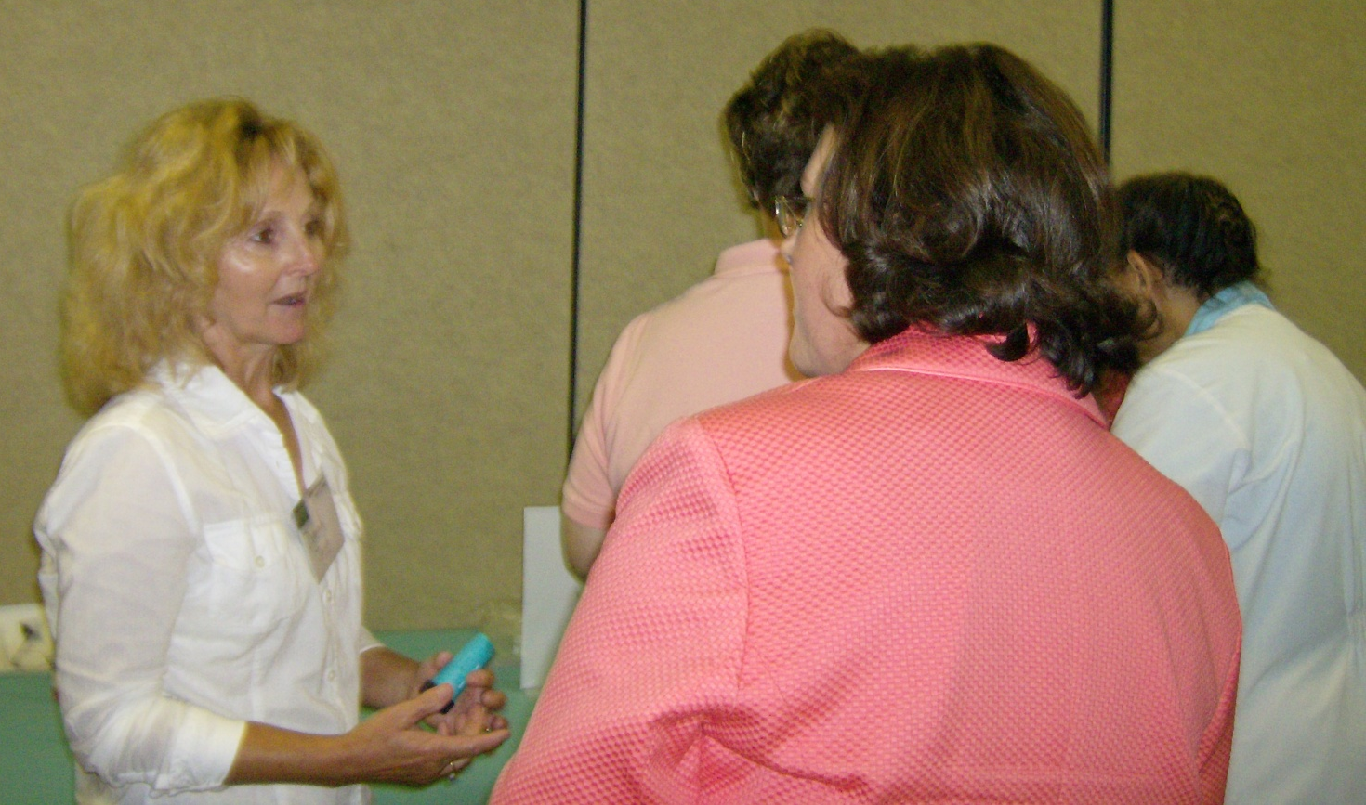
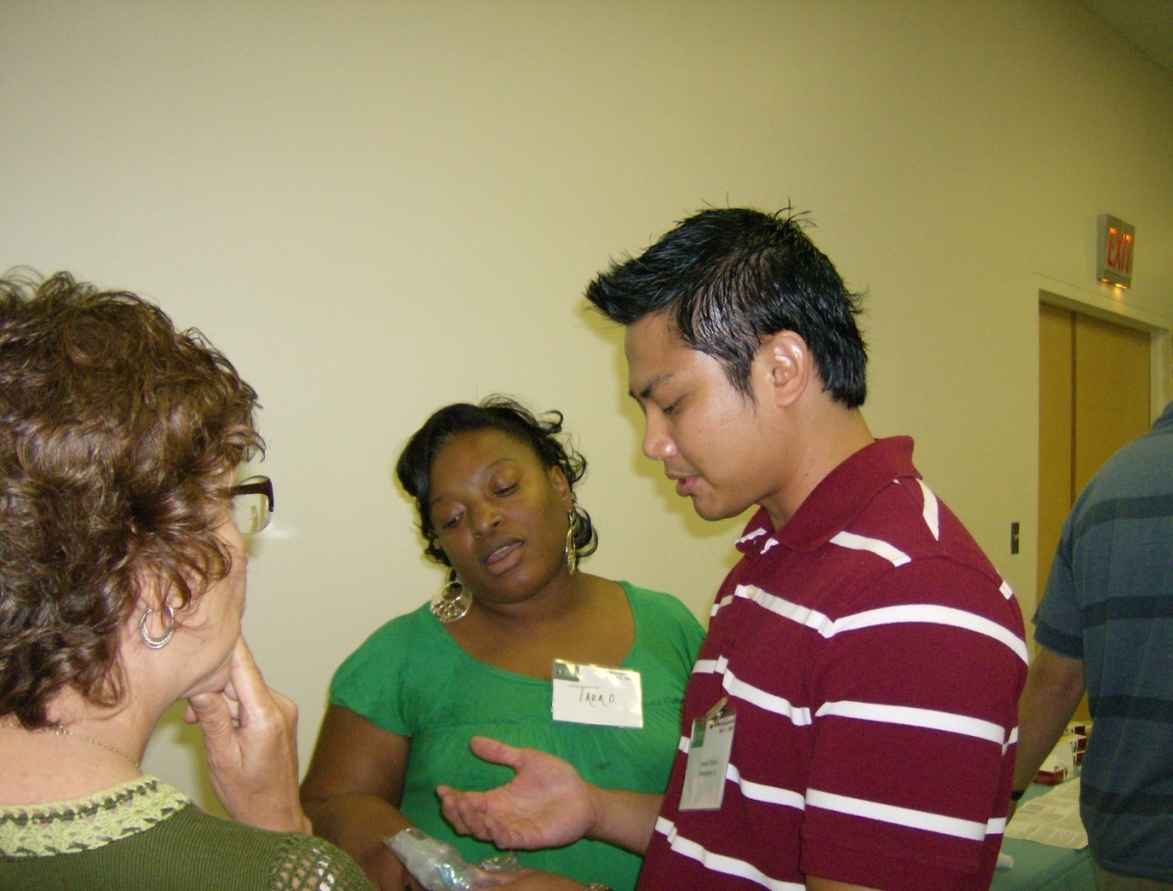
Role Modeling by Accident

Slide 16
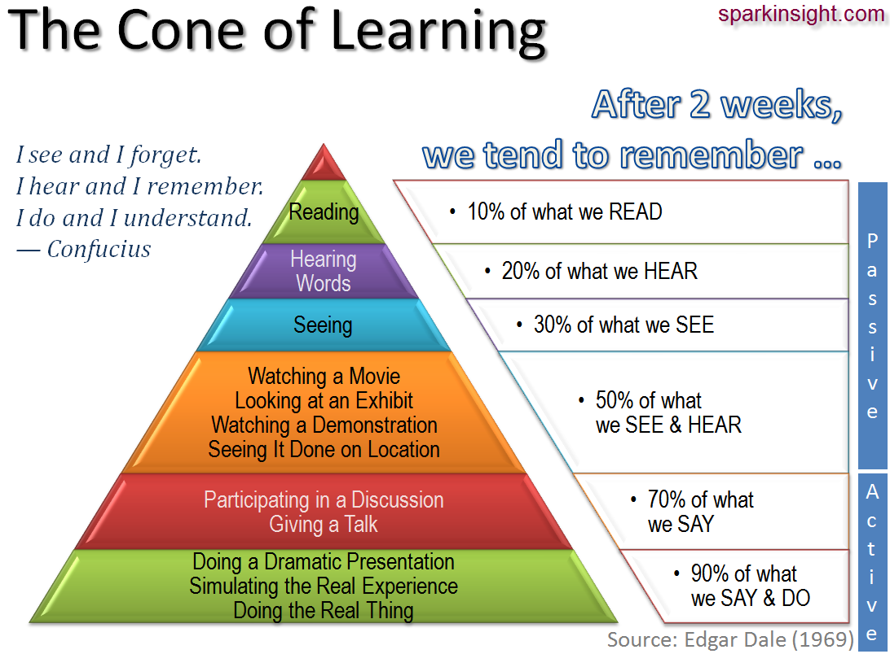

Slide 17
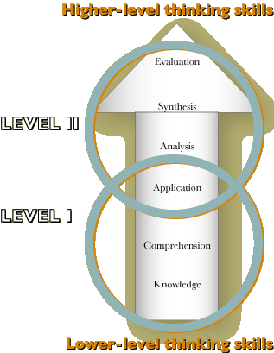

Slide 18
Evaluate Clinical Resources
Who
What
When
Where
How
People
Places
Things
Abstract Ideas

Slide 19
Easy Beginning Strategies
“What would you like to learn today?”
“What did you learn in class this week? Was anything confusing? Let me show you put that into practice today.”
Even if you aren’t the preceptor for the day, be on the lookout for opportunities to engage the student during “down times” – make them feel useful and wanted. Their time DOES matter.

Slide 20
References
The Adult Learner, Sixth Edition: The Definitive Classic in Adult Education and Human Resource Development by Malcolm S. Knowles Ph.D., Elwood F. Holton III Ed.D., and Richard A. Swanson Ph.D.
http://www.ojp.usdoj.gov/ovc/assist/educator/files/chapter3.pdf
http://www.public-health.uiowa.edu/icphp/ed_training/ttt/archive/2002/2002_course_materials/Engaging_Adult_Learners_Effectively_final.pdf

